Slide 1
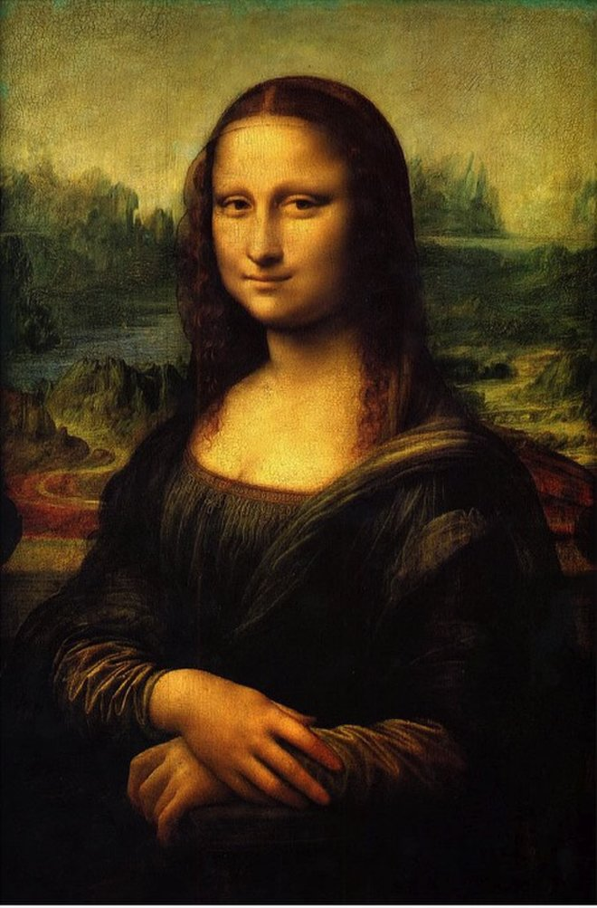
The Art of Finding
The Art of Finding application allows the user to search for images of historic artwork. It provides data about the work of art, as well as the location of the gallery where the art work is currently on display. Google Maps provides the address of the gallery. The user can browse Amazon to purchase images of the art work.

Slide 2
Design Team
Trish Mederos – Back end, Google Maps API
Dameon Mendoza – Front end
Grant Stolz – Team Lead – Back end, Artsy API
Abby Thoresen – Front end Lead

Slide 3
The Art of Finding
We all enjoy fine art (Especially Abby).
It allows you to locate images of historic artwork.
You can print images from the application.
You can purchase images of the artwork from Amazon.

Slide 4
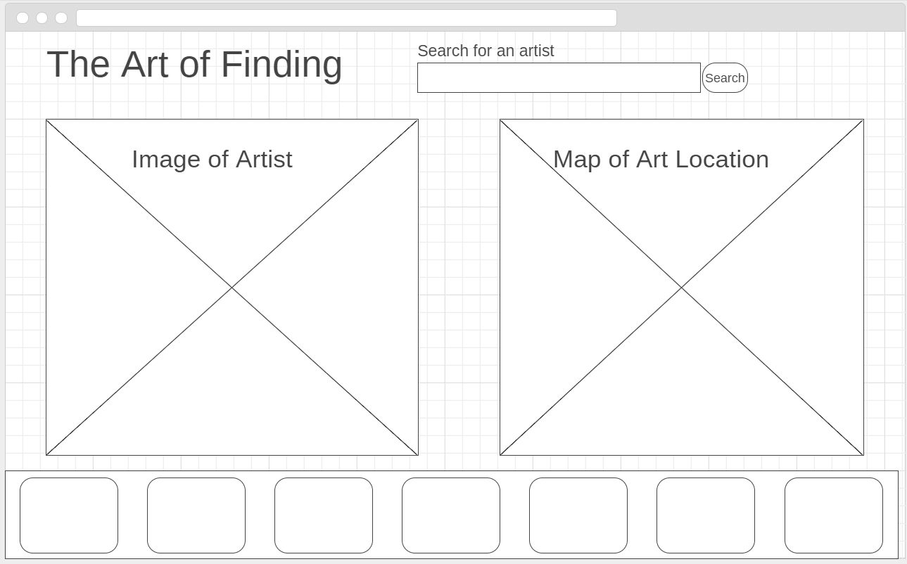
Design Process

Slide 5

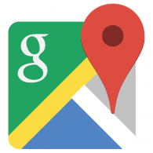
APIs Used
Artsy
Google Maps

Slide 6
Other Technologies
Wireframe.cc
Materialize CSS
Artsy API
Google Maps API
API token authentication
Javascript
JQuery
Ajax
Mobile Friendly/Responsive Design

